Slide 1
Telemetry 2.0 and BulkData

Slide 2
Telemetry 2.0 and BulkData
Telemetry 2.0 Profiles configuration supports most .BulkData.Profile concepts
Variations:
No implementation of Device.BulkData data model
Profile structure/properties kept internal to Telemetry 2.0 component
Using variable length arrays, as per JSON, rather than index-based data tables
Configure via single TR-181 parameter with full set of profiles
No GET support for configuration specifics, e.g., Protocols, EncodingTypes

Slide 3
Enabling Telemetry 2.0 & Report Collection
RFC Parameters :
Device.DeviceInfo.X_RDKCENTRAL-COM_RFC.Feature.Telemetry.Enable (Boolean)
Device.DeviceInfo.X_RDKCENTRALCOM_RFC.Feature.Telemetry.ConfigURL (String)
Device.DeviceInfo.X_RDKCENTRAL-COM_RFC.Feature.Telemetry.Version (String)
‘2.0’ : Operates only with legacy support
‘2.0.1’ : Operates with T2 report profile and legacy support
Profiles Present on Device
WebConfig is intended delivery mechanism

Slide 4
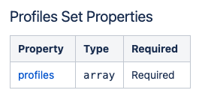
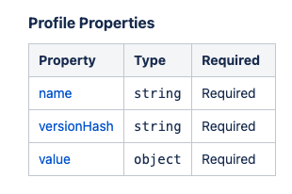
Telemetry 2.0 Report Profiles Configuration
T2 Report Profile Configuration is pushed to device over:
Device.X_RDKCENTRAL-COM_T2.ReportProfiles
( Value must be a json configuration blob in string )
Device.X_RDKCENTRAL-COM_T2.ReportProfilesMsgPack
( Value must be configuration blob in base-64 encoded msgpack format)
Configures Entire Profile Set
Content is a JSON array ”profiles”: [] where each element is a “profile”

Slide 5
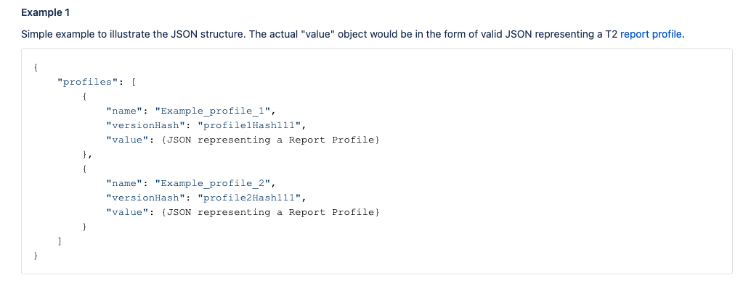
Telemetry 2.0 Report Profiles Structure

Slide 6
Profile Comparison: T2.0 Profile Properties to BulkData data model
.BulkData.Profile.{i}. (index)
.BulkData.Profile.{i}.

Slide 7
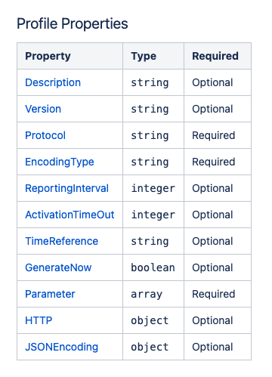
Profile: T2.0 Profile Properties to BulkData data model
.BulkData.Profile.1.Protocol
.BulkData.Profile.1.EncodingType
.BulkData.Profile.1.ReportingInterval
.BulkData.Profile.1.TimeReference
.BulkData.Profile.1.Parameter.{i}.
.BulkData.Profile.1.HTTP
.BulkData.Profile.1.JSONEncoding

Slide 8
Telemetry 2.0 Report Profile JSON
{
"Description": "T2.0 WHiX data - partial for example",
"Version": "0.1",
"Protocol": "HTTP",
"EncodingType": "JSON",
"ReportingInterval": 900,
"TimeReference": "0001-01-01T00:00:00Z",
"HTTP": {
"URL": "https://rdkrtldev.stb.r53.xcal.tv/",
"Compression": "None",
"Method": "POST",
"RequestURIParameter": [
{ "Name": "profileName",
"Reference": "Profile.Name" },
{ "Name": "reportVersion",
"Reference": "Profile.Version" } ]
},
"JSONEncoding": {
"ReportFormat": "NameValuePair",
"ReportTimestamp": "None"
},
”Parameter": [ {see next slide}]
}

Slide 9
Telemetry 2.0 Report Profile JSON: Parameters
{
"Parameter": [
{ "type":"dataModel", "reference":"Profile.Name” } ,
{ "type":"dataModel", "reference":"Profile.Version” },
{ "type":"dataModel", "name":"24Enable", "reference":"Device.WiFi.AccessPoint.1.Enable” } ,
{ "type": "grep", "marker": "WIFI_BYTESSENTCLIENTS_1", "search": "WIFI_BYTESSENTCLIENTS_1:", "logFile": "wifihealth.txt” },
{ "type": "event", "eventName": "WIFI_CWconfig_1_split", "component": "ccsp-wifi-agent”, ”use”:”absolute” }
]
}

Slide 10
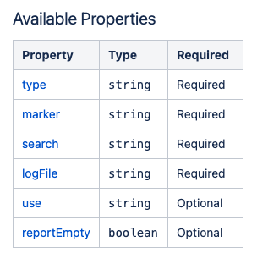
Parameter Type: grep
Gives backward compatible support for existing RDK Telemetry

Slide 11
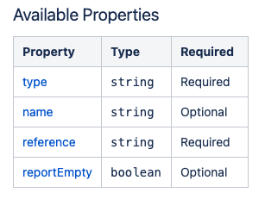
Parameter Type: dataModel
Gives access to system data model, like BulkData “.Reference”

Slide 12
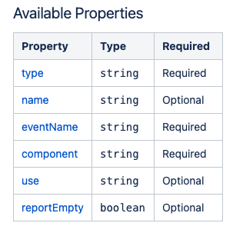
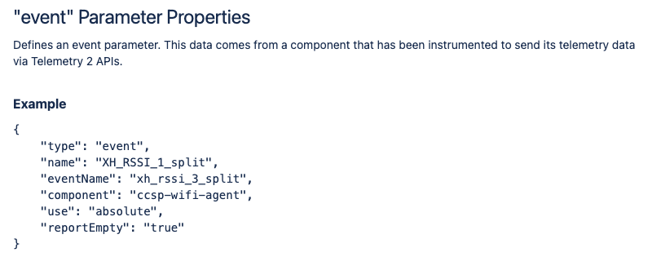
Parameter Type: event
Allows new source of telemetry data direct from components

Slide 13
Telemetry 2.0 Future Features/Roadmap
Report on Condition (TriggerCondition) – development complete
Possible New Encoding Types
AVRO
Possible New Protocol Types
Xmidt
MQTT
Possible support for other BulkData properties, e.g.:
TimeReference
NumberOfRetainedFailedReports

Slide 14
Telemetry 2.0 in RDK Builds
In RDK-B and RDK-V builds now
RPI
XConf supports Telemetry 2.0 Profiles as of Release 3.5

